Slide 2
Systematic Literature Review
Rully Agung Yudhiantara, M.Pd
NIP. 197911222015031004
(Pend Bahasa Inggris, FTK, UIN SGD)
Editor Jurnal Pendidikan Islam (Scopus Q2)
rully.agung@uinsgd.ac.id

Slide 6
SLR AND PRISMA MODEL
Petticrew, M., & Roberts, H. (2006). Systematic Reviews in the Social Sciences: A Practical Guide. Wiley. https://doi.org/10.1002/9780470754887
They have authored key texts on systematic reviews in the social sciences, outlining methodologies and frameworks for conducting systematic reviews beyond healthcare.
The PRISMA (Preferred Reporting Items for Systematic Reviews and Meta-Analyses) model provides a structured framework for conducting and reporting systematic reviews. It ensures transparency, reproducibility, and comprehensiveness in systematic literature reviews (SLRs).

Slide 7
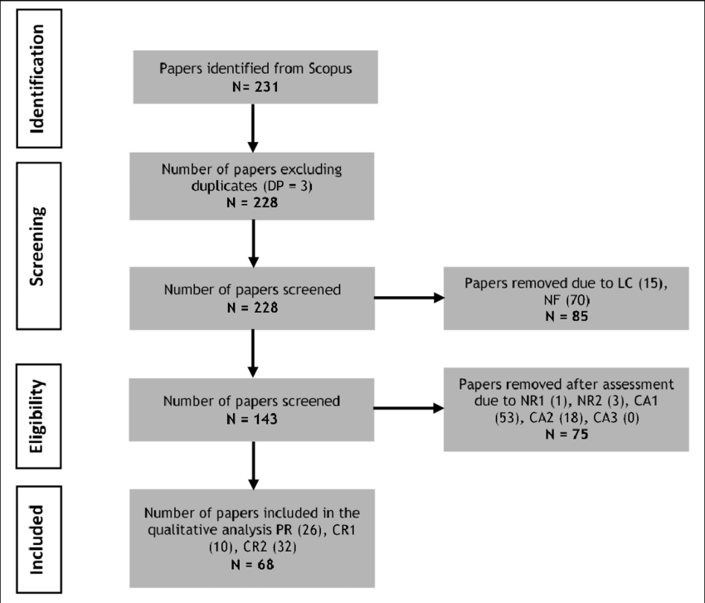

Slide 8
EXAMPLE OF SLR AND PRISMA MODEL

Slide 9
FORMULATING RESEARCH QUESTIONS SLR
How is the profile of publications on the topic of accountability in pondok pesantren?
How is the comparison of the methods and results of research that examines the accountability of pondok pesantren?
What relevant topics are related to the topic of pondok pesantren accountability?
What is the future research agenda related to the topic of pondok pesantren accountability?

Slide 10
SLR STAGES
The SLR research stages include:
1. planning research questions,
2. systematically searching for literature reviews,
3. filtering and selecting appropriate research articles,
4. conducting analysis and synthesis of qualitative findings,
5. implementing quality control and preparing the final report (Alhossini, Ntim, and Zalata (2021) and Alatawi, Ntim, Zras, and Elmagrhi (2023)

Slide 11
STEPS TO CONDUCT SLR
There are four steps;
identification of the resources,
2. search by the keywords,
3. excluding and including, and analysis the results (Lu, Ntim, Zhang, & Li, 2022).

Slide 14
BENEFITS SLR FOR FURTHER STUDY
The future research agenda on accountability of pondok pesantren is still interesting to study using various approaches and research methods.
This specific topic will review the phenomenon of asset management in pondok pesantren starting from planning to utilization and reporting.
Another interesting topic is the relationship between variables that influence the accountability of pondok pesantren management quantitatively.
Kiai’s central position in the pondok pesantren is undeniable. However, the creation of accountability in pondok pesantren is growing and requires attention from various parties to increase public trust in pondok pesantren.
In addition, the application of governance based on Islamic values and local culture will provide interesting and more comprehensive studies, not limited to accountabilit

Slide 15
Finding Relevant Literature
Sources of Information relevant to Islamic religious education:
key databases,
National/ sinta, international DOAJ, Scopus, WoS
Publisher (Elsevier, Sage, taylor and Francis
journals

Slide 16
Strategies to search relevant articles
Use keywords
and advanced search techniques to find relevant articles.

Slide 17
Evaluating Sources
Criteria for Selection: how to assess the credibility, relevance, and quality of sources
Peer-reviewed Journals vs. Other Sources: the importance of peer-reviewed articles and how they differ from other sources like books, conference papers, and online content.
Impact Factor and H-index: metrics to evaluate the influence of journals and authors.

Slide 18
Reading and Analyzing Articles
Reading Techniques: how to efficiently read academic articles, focusing on abstracts, introductions, methods, results, and conclusions
Critical Analysis: how to critically analyze the arguments, methodologies, and findings of studies.
Note-taking and Summarization: effective methods for taking notes and summarizing key points.

Slide 19
Organizing the Literature
Thematic Organization: grouping literature by themes, methodologies, theoretical frameworks, or historical development
Creating an Outline: creating a structured outline for the literature review

Slide 20
Writing the Literature Review
Structure of a Literature Review: the typical structure (introduction, body, conclusion)
Synthesis vs. Summary: the importance of synthesizing information rather than merely summarizing it
Writing Tips: academic writing style, clarity, coherence, and avoiding plagiarism

Slide 21
Referencing and Citation
Citation Styles: common citation styles (APA, Chicago, MLA) and their use in Islamic studies.
Reference Management Tools: EndNote, Mendeley, or Zotero for managing citations and creating bibliographies.

Slide 22
PRACTICE

Slide 23
TERIMA KASIH

